Slide 1

Prediction Of Rainfall Using ML Techniques
Subject: Computer Science Research
Project Mentor: Dr. Arash Rafiey
Name: Sahana Vasudev (991973717)

Slide 2
LASSO REGRESSION MODEL
Introduction:
In statistics and machine learning, lasso is a relapse examination technique that performs both variable choice and regularization so as to improve the forecast precision and interpretability of the factual model it produces. It was initially presented in geophysics writing in 1986, and later freely rediscovered and promoted in 1996 by Robert Tibshirani, who begat the term and gave further bits of knowledge into the watched exhibition.

Slide 3
Definition of Lasso Regression:
Lasso regression is like linear regression, but it uses a technique “shrinkage” where the coefficients of determination are shrunk towards zero.
Linear regression gives you regression coefficients. The lasso regression allows you to shrink or regularize these coefficients to avoid overfitting and make them work better on different datasets.
This type of regression is used when the dataset shows high multicollinearity or when you want to automate variable elimination and feature selection.

Slide 4
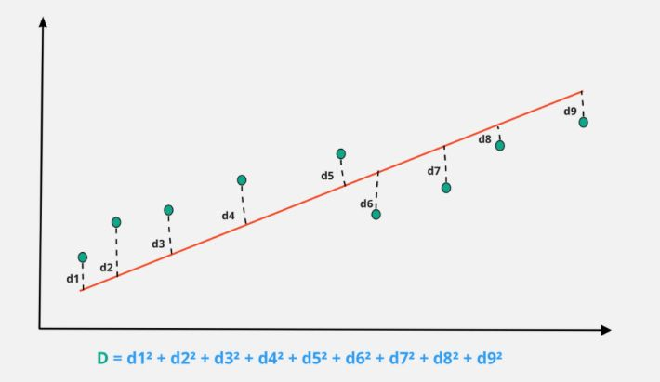
The Statistics of Lasso Regression:
d1, d2, d3, etc., represents the distance between the actual data points and the model line in the graph.
Least-squares is the sum of squares of distance between the points from the plotted curve.
While performing lasso regression, we add a penalizing factor to the least-squares. That is, the model is chosen in a way to reduce the below loss function to a minimal value.
D = least squares + Lambda * summation (absolute values of the magnitude of the coefficients)

Slide 5
Lasso regression penalty consists of all the estimated parameters. Lambda can be any value between zero to infinity. This value decides how aggressive regularization is performed. It is usually chosen using cross-validation.
Lasso penalizes the sum of absolute values of coefficients. As the lambda value increases, coefficients decrease and eventually become zero This way, lasso regression eliminates insignificant variables from our model.
Lasso regression penalizes less important features of your dataset and makes their respective coefficients zero, thereby eliminating them. Thus it provides you with the benefit of feature selection and simple model creation.
So, if the dataset has high dimensionality and high correlation, lasso regression can be used.

Slide 6
Thank you

